Slide 1

Trading Robot FOREX
Dean Gani

Slide 2


Introduction
Develop an Automated Trading System
Optimize Trading Decisions
Key Features:
MetaTrader 5 Integration
Multiple Trading Strategies
Portfolio Optimization
Risk Management Techniques

Slide 3
MetaTrader
MetaTrader 5 Overview:
What is MetaTrader 5?:
MetaTrader 5 (MT5) is a popular platform for trading Forex, stocks, futures, and CFDs. It provides robust tools for technical analysis, automated trading (via Expert Advisors), and order execution.
Why Integrate with MT5?:
Real-time Market Data: MT5 allows access to real-time data for accurate and timely decision-making.
Automated Trading: Integration enables automated execution of trading strategies, reducing the need for manual intervention.
Broad Asset Coverage: Supports trading across various asset classes, including currency pairs, commodities, indices, and more.

Slide 4
Steps in the Integration Process
Initialization:
Establishes a connection with the MetaTrader 5 terminal from Python.
Account Login:
Logs into a specific trading account to fetch data and execute trades.
Fetching Historical Data:
Retrieves historical price data for various financial instruments, which is crucial for backtesting and strategy development.

Slide 5
Purpose of Technical Indicators:
Market Analysis: Analyze market conditions, identify trends, and generate trading signals.
Decision Support: Provide quantitative metrics to support trading decisions and reduce subjective judgment.

Slide 6
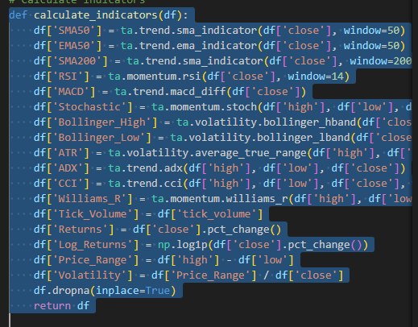
Some used indicators
Simple Moving Average (SMA):
Averages prices over a specific period to identify trends.
Relative Strength Index (RSI):
Identifies overbought or oversold conditions.
Bollinger Bands:
Indicates volatility by plotting bands around a moving average.
Stochastic Oscillator:
Compares closing prices to a price range.

Slide 7

Trading Stategies
Fibonacci Retracement:
Description: Uses Fibonacci levels to identify potential support and resistance zones.
Signal:
Buy: When price is in the golden zone (50%-61.8% retracement).
Sell: When price retraces to 38.2% level and starts to reverse.
Breakout Strategy:
Description: Identifies and trades when the price breaks out of a predefined range or level.
Signal:
Buy: When price breaks above the Bollinger Band with high volume.
Sell: When price breaks below the Bollinger Band with high volume.

Slide 8

Model Training and Evaluation
XGBoost with Bayesian Optimization:
XGBoost is the primary model used in the trading system to predict future price movements based on historical data and technical indicators.
How It Works:
XGBoost builds decision trees that are combined to make more accurate predictions.
Bayesian Optimization is used to fine-tune the model’s parameters (like the number of trees and learning rate), ensuring it performs optimally in predicting whether the price will go up or down.
This model is crucial for generating buy/sell signals by analyzing patterns in the indicators.

Slide 9
Model Training and Evaluation
Random Forest:
Acts as a complementary model to validate predictions from XGBoost.
How It Works:
Random Forest creates multiple decision trees using different subsets of the data and combines their outputs.
It helps in reducing overfitting, ensuring the model generalizes well to unseen data.
This model supports the overall decision-making process by confirming the signals generated.

Slide 10

Model Training and Evaluation
Gradient Boosting:
Provides an additional layer of prediction by focusing on correcting errors made by previous models.
How It Works:
Gradient Boosting iteratively improves predictions by emphasizing harder-to-predict instances in the dataset.
It strengthens the accuracy of predictions, particularly in complex market scenarios, helping to refine the final trading decisions.

Slide 11

Model Training and Evaluation
Gaussian Naive Bayes:
Used as a baseline model to compare with more complex models and to add another layer of probability estimation.
How It Works:
This model calculates the probability of price movement based on the assumption that each indicator is independent of the others.
It’s simpler and faster, providing a quick assessment of whether a trade should be made.

Slide 12
Advanced Techniques(Probabilities)
Monte Carlo Simulation:
Simulates multiple outcomes to estimate the probability of a successful trade.
Ensures trades are only executed with high confidence.
Bayesian Update:
Refines trade success probability by updating prior beliefs with new data.
Enhances decision accuracy through probability adjustments.

Slide 13
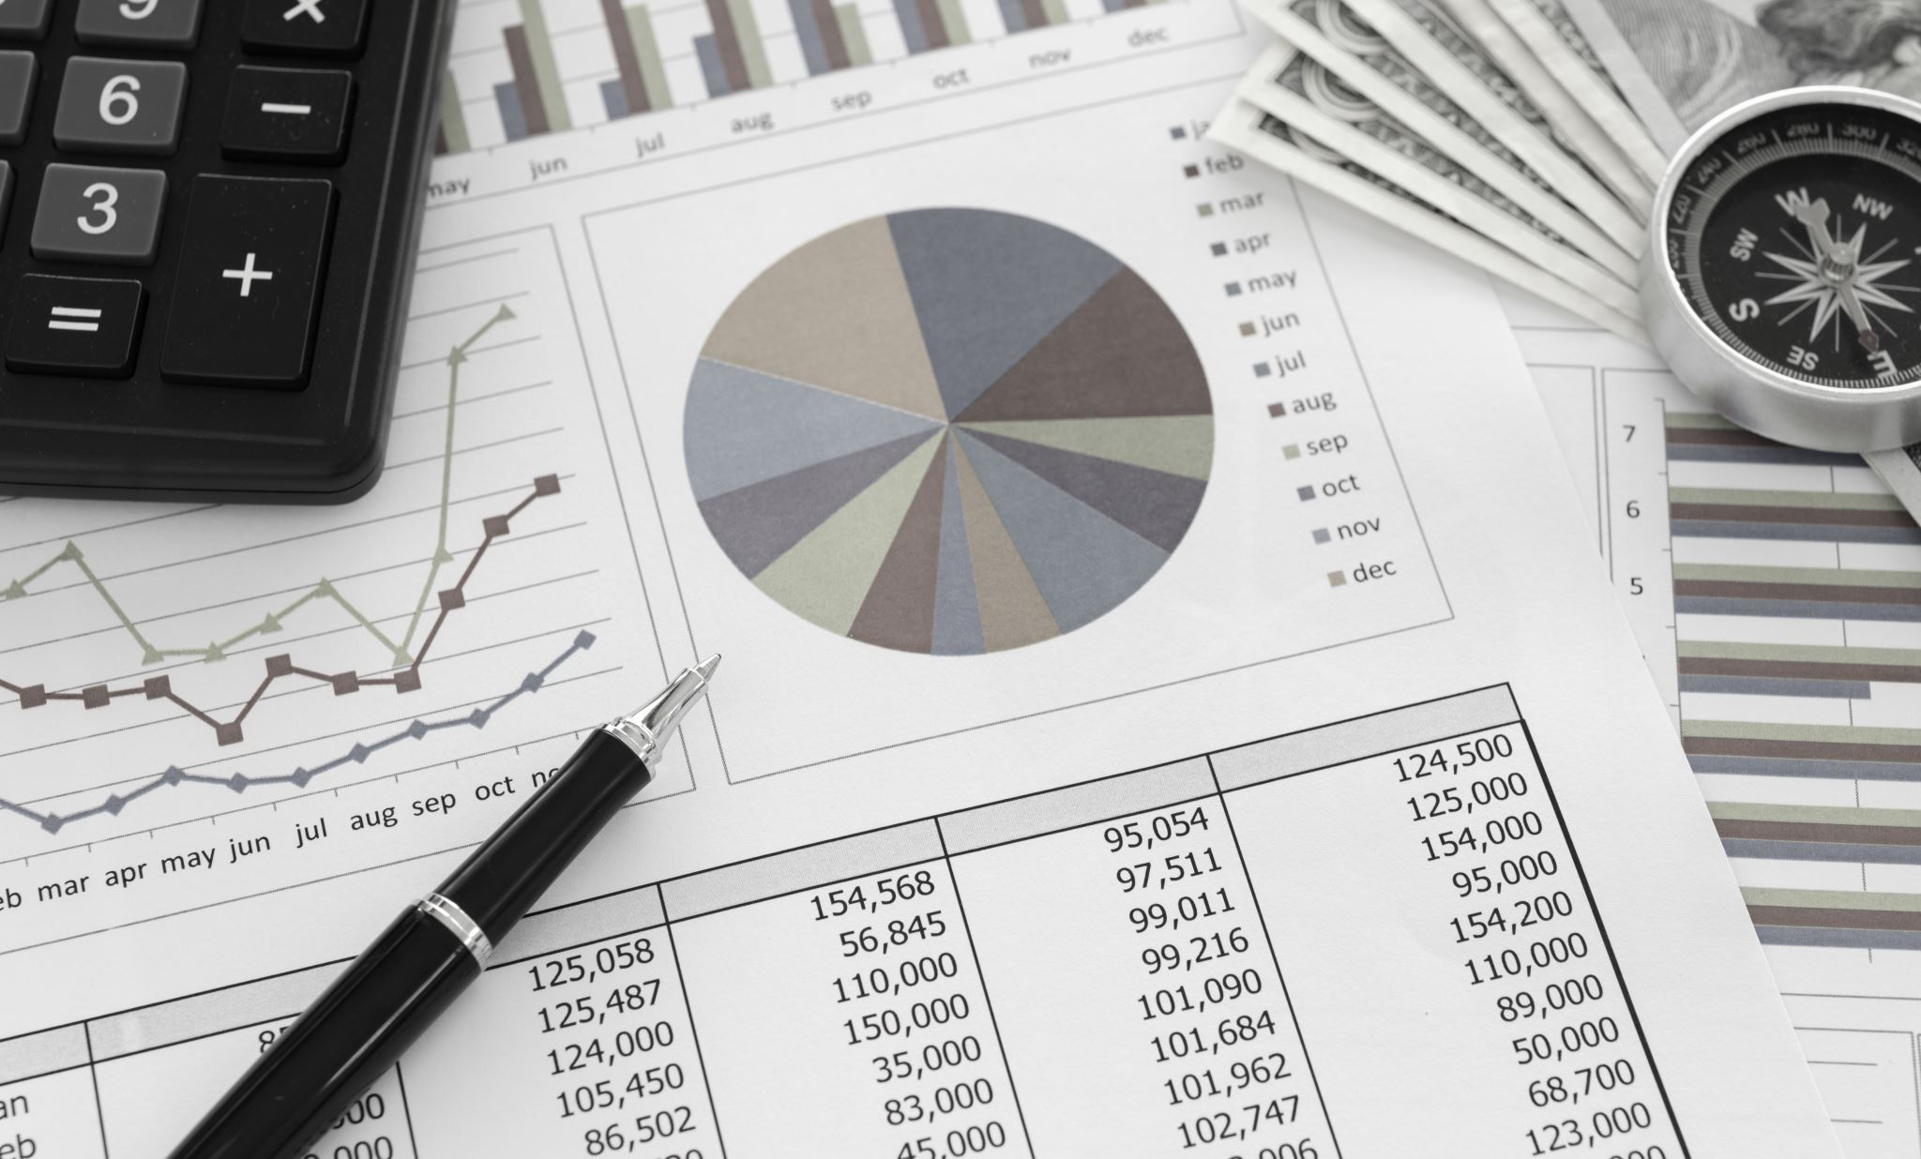
Advanced Techniques(Probabilities)
Naive Bayes Probability:
Provides an additional probability estimate to support trade decisions.
Combined with Bayesian update for robust decision-making.
Model Calibration:
Adjusts model probabilities to align closely with real outcomes.
Ensures the 80% confidence threshold is accurately met.

Slide 14

Advanced Techniques(Probabilities)
Monte Carlo Dropout:
Adds uncertainty estimation to neural network predictions.
Provides confidence intervals for trade decisions.
Quantile Regression:
Predicts different price levels (quantiles) for more informed risk management.
Helps set precise stop-loss and take-profit levels.

Slide 15

Reinforcement Learning (RL)
Reinforcement Learning Overview:
Uses RL to optimize trading decisions by learning from the environment and adjusting strategies based on rewards.
How It Works in the Project:
The system is trained in a simulated trading environment using the Proximal Policy Optimization (PPO) algorithm.
The RL agent learns by interacting with the environment, taking actions (buy, sell, hold), and receiving rewards based on the profitability of these actions.

Slide 16
Reinforcement Learning (RL)
Steps Involved:
The RL agent starts with no knowledge of the market and explores different actions.
Over time, it learns to maximize rewards by identifying profitable trading patterns.
The agent's strategy improves with each iteration, gradually converging on an optimal trading policy.
Model Performance:
The RL model is trained over thousands of timesteps to ensure it can handle various market conditions.
Performance is evaluated by backtesting the RL model on historical data, comparing its profitability against other models.

Slide 17
Final Thought
Advance with the trading bot in more advance techniques.
News API(expensive)
Advanced Topic ( Cloud Service)
NLP(Extracting words from social medias or news provider and make an expression to the model what happends to the market if that words are online)

Slide 18
Questions ?
David???????

